Slide 1
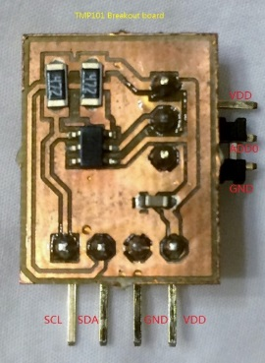
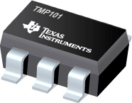
Lecture 16 ARM I2C Modules
References
I2C Standard
Lab #9 Part 1: Connecting Two TMP101 Sensors to Zybo on MIO and SelectIO
I2C Controller Module of Zynq 7000
Xilinx I2C Software Driver Library

Slide 2
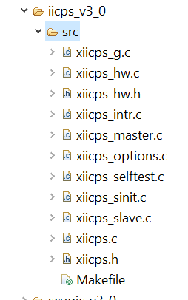
ARM I2C Module References
Chapter 20 I2C Controller, Zynq-7000 All Programmable SoC, Technical Reference Manual, UG585 (v1.10) February 23, 2015
Xilinx Processor IP Library – iicps_v3_0 C:\Xilinx\SDK\2015.2\data\embeddedsw\XilinxProcessorIPLib\drivers\iicps_v3_0

Slide 3
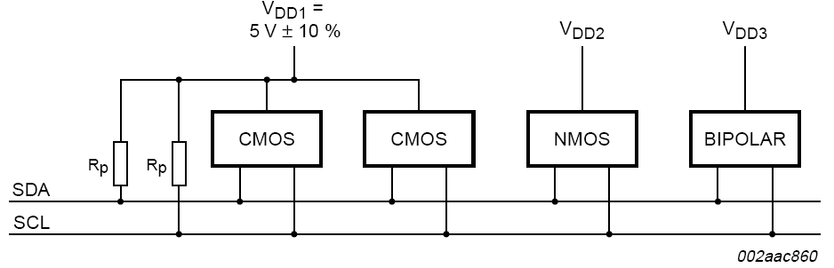
I2C is a 2-Wire Serial Bus (plus the common voltage reference wire)
SDA – Serial Data Line
SCL – Serial Clock Line
Ground – common voltage reference line
Two pull-up resistors of 4.7kΩ

Slide 4
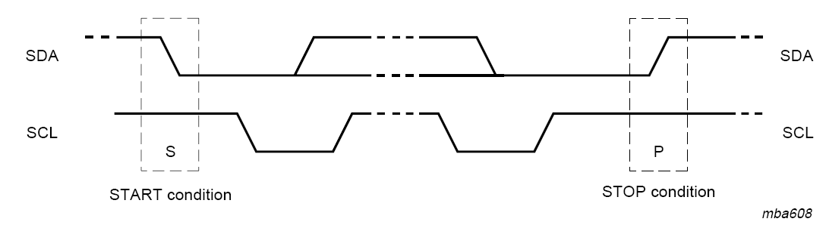
Start and Stop Conditions
Start condition is when SCL=1 and SDA goes from 1 to 0
Stop condition is when SCL=1 and SDA goes from 0 to 1
Notice data line SDA cannot change when SCL=1 to set data values because SDA change indicates Start or Stop when SCL=1.

Slide 5
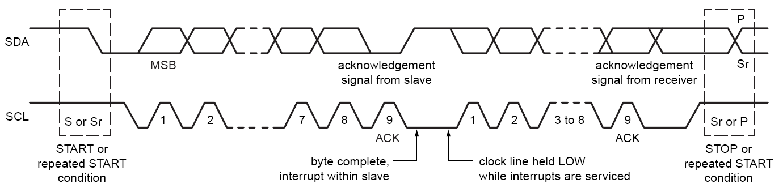
Data Transfer
I2C bus is idle when both SDA and SCL are high “1” or hi-Z
Data transfer starts after Start Bit appears
Each frame after Start Bit is 9 bits long: eight bit data and one bit acknowledgement
Data transfer may continue until Stop Bit appears

Slide 6
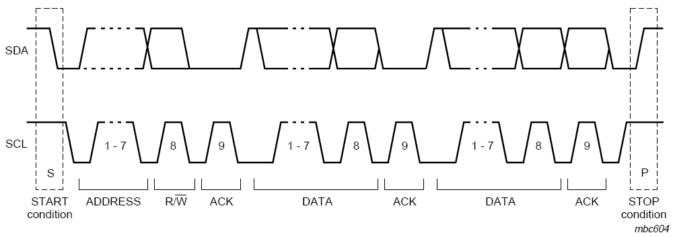
An Example Data Transfer Sequence

Slide 7
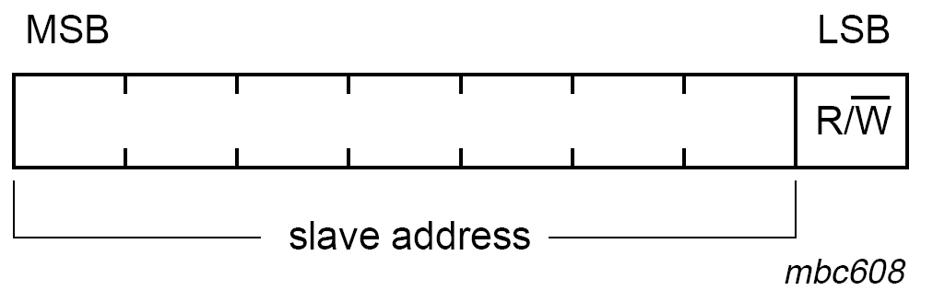
The First Byte Is Composed of 7-bit Address and $R/\overline{W}$ bit
Slave address is 7 bits long
The least significant bit is Read (“1”) or Write (“0”) bit to inform the device at the address to be ready for read or write operation

Slide 8
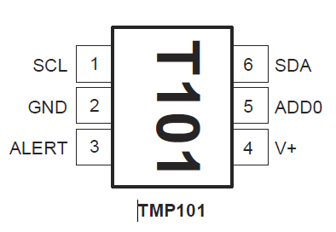
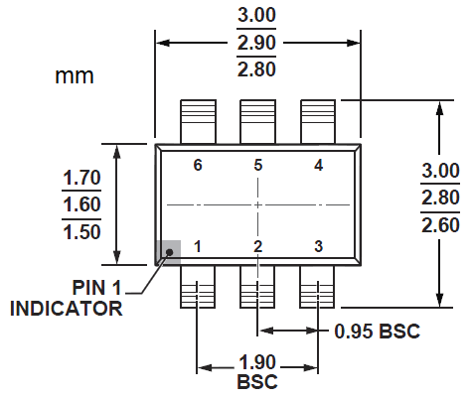
TMP101 Digital Temperature Sensor With I2C from TI
Features
DIGITAL OUTPUT: I2C Serial 2-Wire
RESOLUTION: 9- to 12-Bits, User-Selectable
ACCURACY:
±2.0°C from −25°C to +85°C (max)
±3.0°C from −55°C to +125°C (max)
LOW QUIESCENT CURRENT:
WIDE SUPPLY RANGE: 2.7V to 5.5V
TINY SOT23-6 PACKAGE
Three Addresses
ADD0=0: 7’b1001000
ADD0=1: 7’b1001010
ADD0 floating: 7’b1001001
Alert Pin
One-shot conversion
Limits Status Warning
Notes:
OS/ALERT (OS)
The TMP100 and TMP101 feature a One-Shot
Temperature Measurement Mode. When the device is in
Shutdown Mode, writing a 1 to the OS/ALERT bit will start
a single temperature conversion. The device will return to
the shutdown state at the completion of the single
conversion. This is useful to reduce power consumption in
the TMP100 and TMP101 when continuous monitoring of
temperature is not required.
Reading the OS/ALERT bit will provide information about
the Comparator Mode status. The state of the POL bit will
invert the polarity of data returned from the OS/ALERT bit.
For POL = 0, the OS/ALERT will read as 1 until the
temperature equals or exceeds THIGH for the programmed
number of consecutive faults, causing the OS/ALERT bit
to read as 0. The OS/ALERT bit will continue to read as 0
until the temperature falls below TLOW for the programmed
number of consecutive faults when it will again read as 1.
The status of the TM bit does not affect the status of the
OS/ALERT bit.

Slide 9
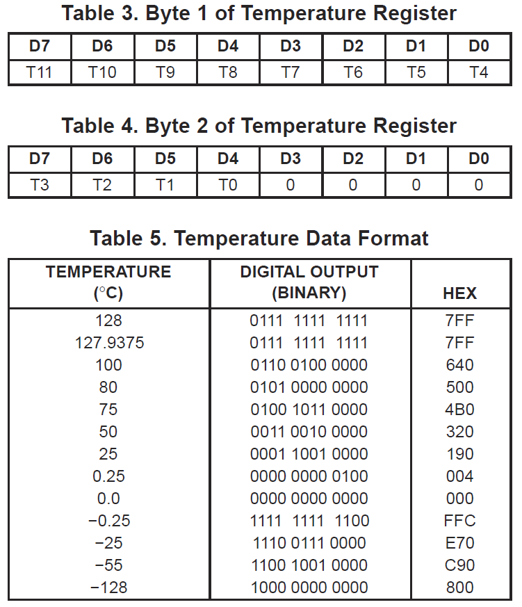

TMP101 Temperature Registers Byte 1 and Byte 2
Two byte left aligned
Up to 12-bit resolution
Byte 1 and D7-4 of Byte 2
Bit D0 of Byte 1 represents $1℃ resolution$, T4
Reading Byte 1 is sufficient to obtain $1℃$ resolution, T11-4
The smallest resolution T0 of TMP101 is bit D4 of Byte 2: $0.0625℃$

Slide 10
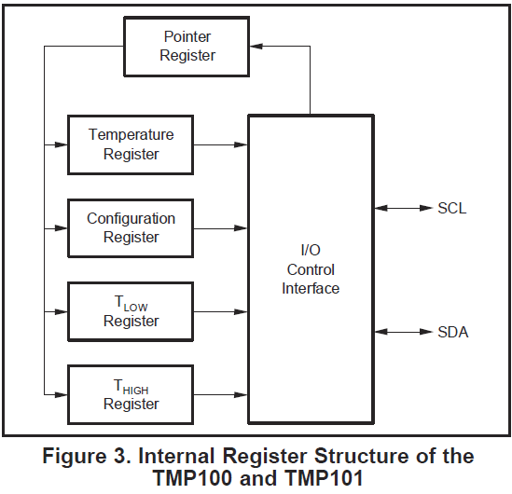
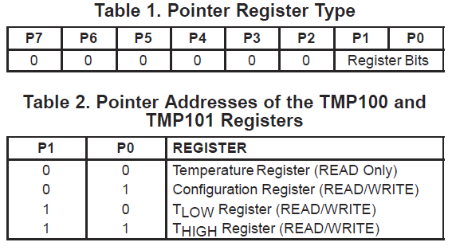
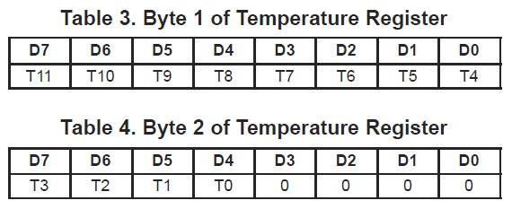
TMP101 Pointer Register
Pointer Register
Stores address of register to be accessed
Temperature
12 bits in two Bytes 1 and 2
Configuration
T_{LOW}
T_{HIGH}

Slide 11
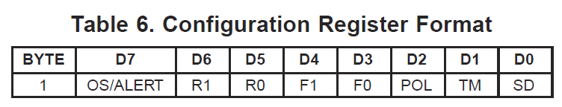
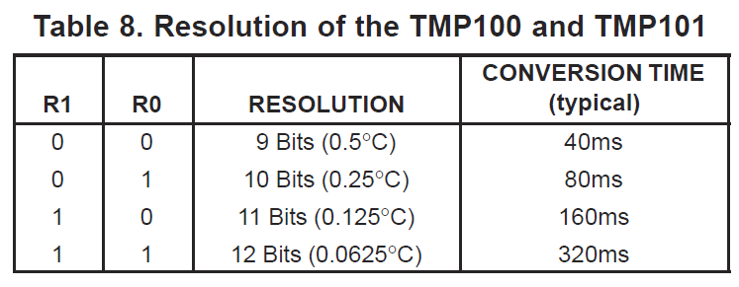
TMP101 Configuration Register
Configuration
R1 and R0 are resolution bits to change speed and resolution
OS/ALERT is Special event alert output
F1 and F0 are Fault Queue bits to set triggering tolerance
POL is Polarity of Alert Active Mode
TM is Thermostat Mode: comparator mode or interrupt mode
SD is Shut Down Mode to save power instead of continuous conversion
T_{LOW} and T_{HIGH} are two upper and lower limit registers

Slide 12
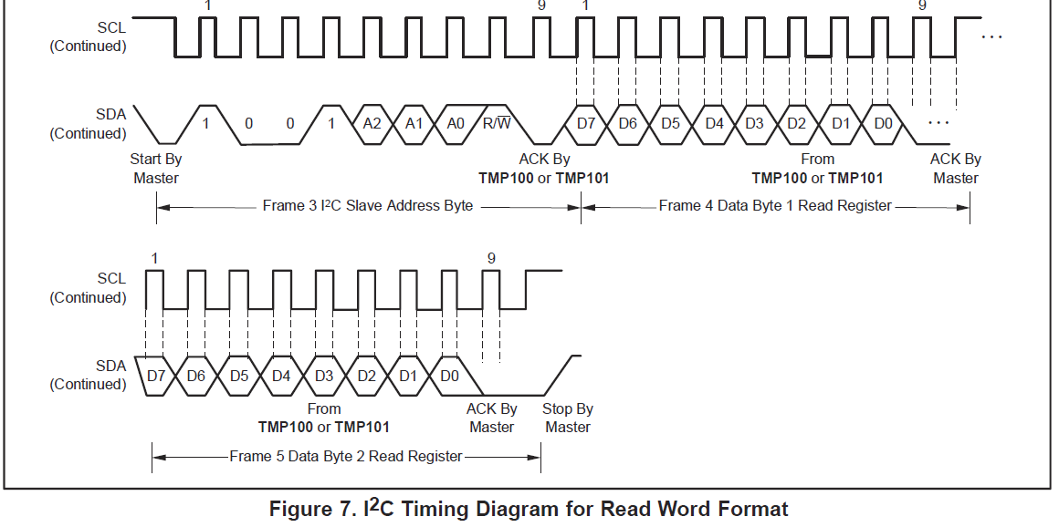
TMP101 Reading

Slide 13
I2C Command Sequence to Read TMP101 at 1001010
To read temperature
Start
0b10010101 //Send Device Address and Read Operation
Receive the higher byte of Temperature
Receive the lower byte of Temperature
Stop
To set pointer register
Start
0b10010100 //Send Device Address and Write Operation
0b00000011 //pointer register =2 for T_{HIGH} Register
Write to lower byte of T_{HIGH} Register
Write to higher byte of T_{HIGH} Register
Stop

Slide 14

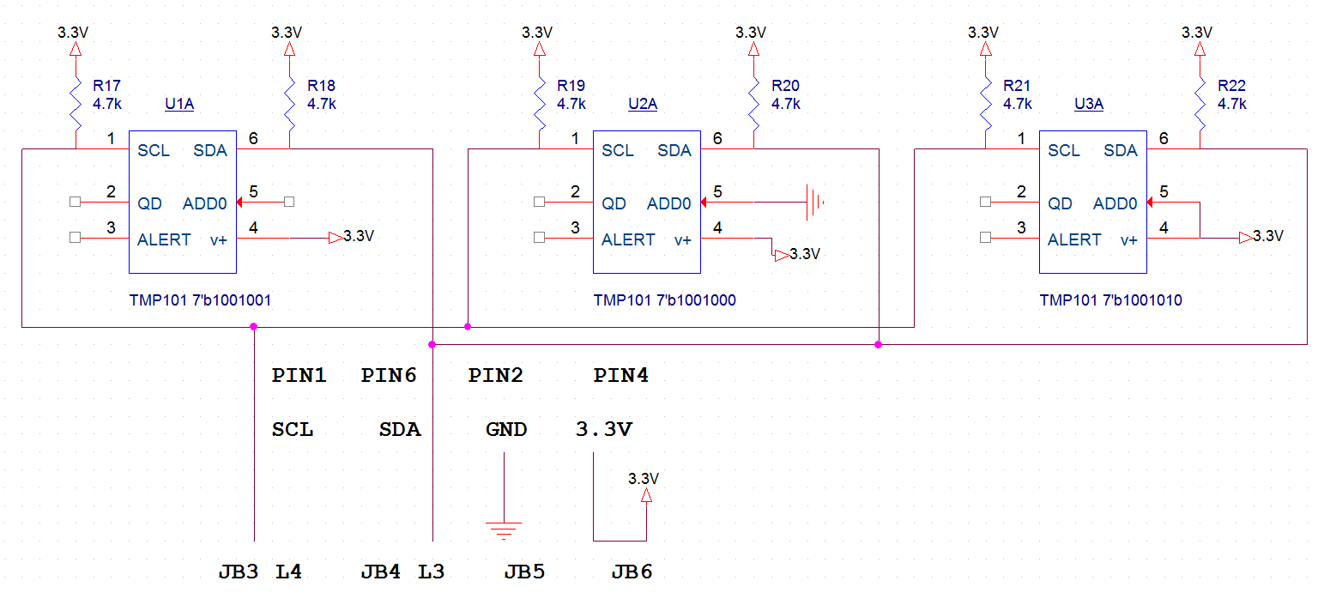
TMP101 Breakout Board Circuit Schematic with Nexys 3 Board
TMP101 breakout board
Pin 1 SCL
Pin 2 SDA
Pin 3 GND
Pin 4 V+

Slide 15
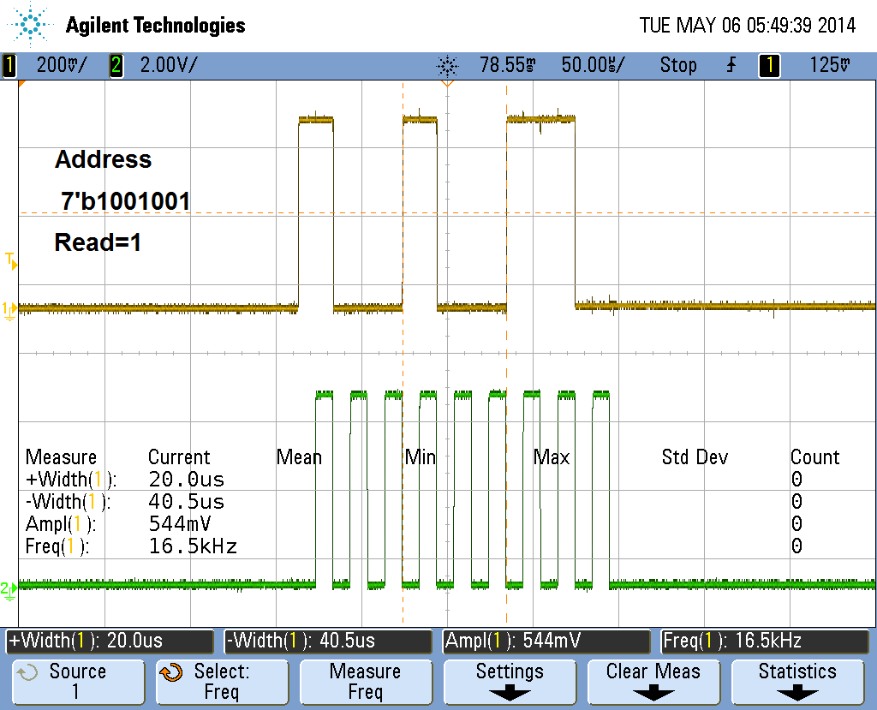
TMP101 I2C Waveforms: Slave Address=7’b1001001
Acknowledgment

Slide 16
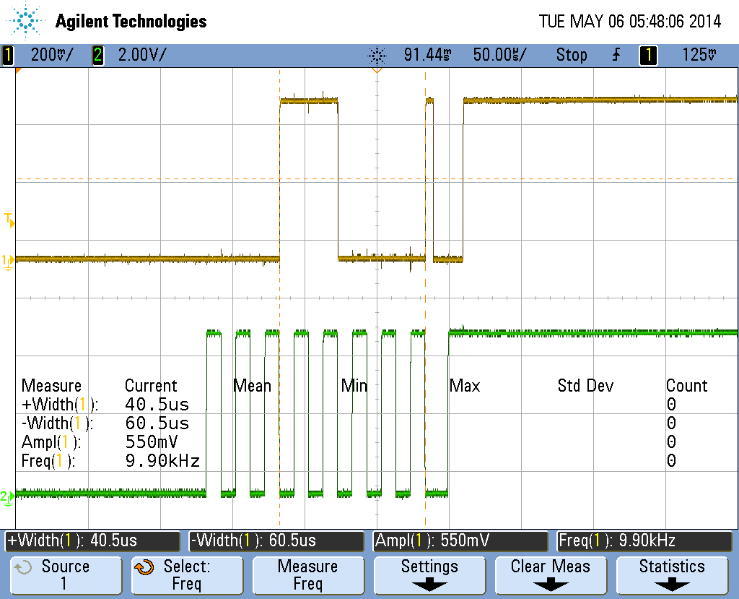
TMP101 I2C Waveforms: Temperature and Stop
Temperature
8’b00011000
20 Celsius
Stop

Slide 17
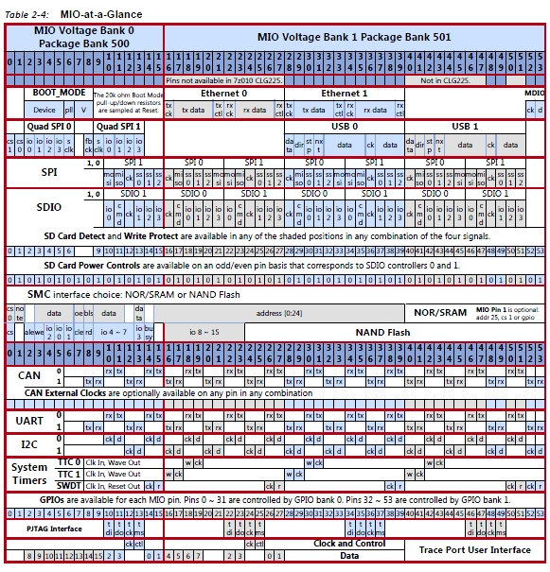
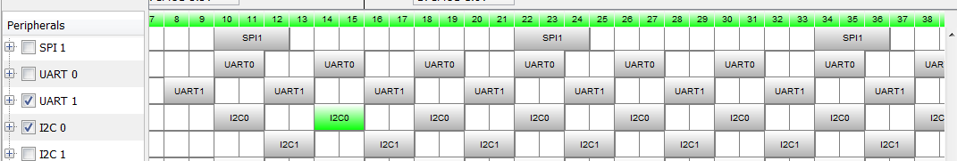
Lab #9 Part 1: Zynq 7000 MIO at a Glance and I2C 0 and I2C 1 MIO Pins
I2C 0 (SCK,SDL):
10-11, 14-15, 18-19
22-23, 26,27, 30-31, etc.
I2C 1 (SCK,SDL)
12-13, 16-17, 20-21
24-25, 28-29, 32-33, etc.
Zynq-7000 All Programmable SoC, Technical Reference Manual, UG585

Slide 18
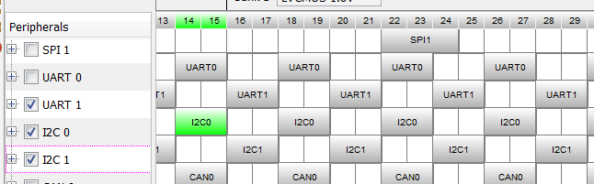
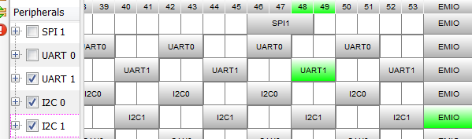
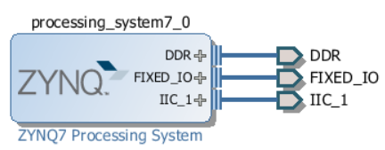
Lab #9 Part 1: Two TMP101 Breakout Boards on MIO and EMIO with ARM I2C Modules
Create a Zynq block design and double click it to open Re-Customized IP menu. Choose Peripheral IO Pins
Select I2C 0 to be connect to MIO pins 14 and 15 on PS
Select I2C 1 to be connect on EMIO through PL, terminal IIC_1
Bit stream file is needed to create interconnect for Select IO pins
Zynq-7000 All Programmable SoC, Technical Reference Manual, UG585

Slide 19
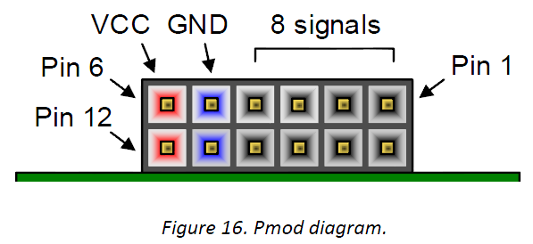
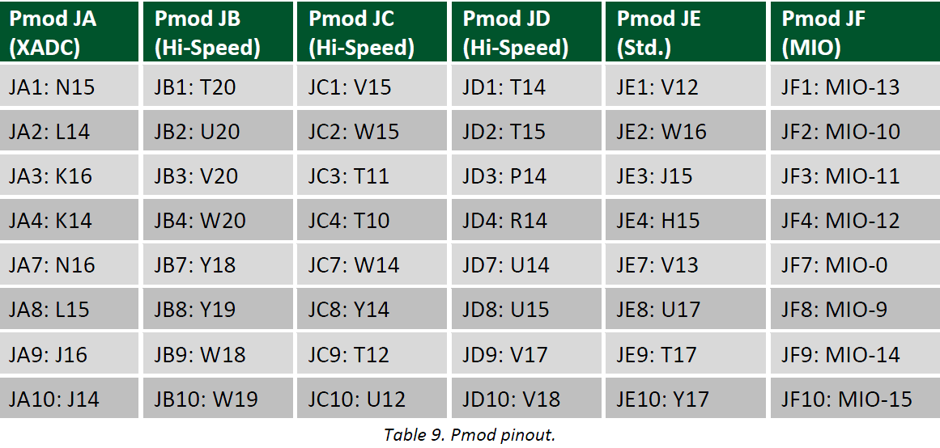
Lab #9 Part 1: Connecting TMP101 Sensors to Zybo through MIO and SelectIO
TMP101A - SCL, SDA, GND, V+ to JF9, JF10, JF11, JF12 on MIO
JF9=MIO14 SDL, JF10=MIO15 SCK, MIO pins
TMP101B - SCL, SDA, GND, V+ to JB3, JB4, JB5, JB6 on EMIO
JB3=V20, JB4=W20, SelectIO pins

Slide 20
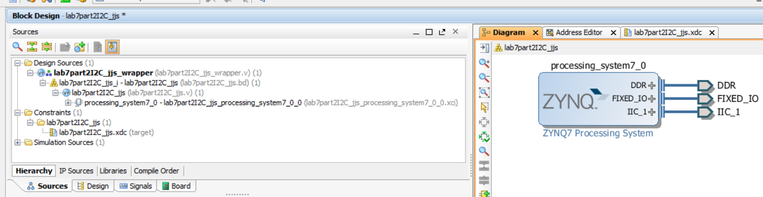
Lab #9 Part 1: Vivado Block Design and Constraint XDC File
Notice I2C 1 is accessible on the ZYNQ block
Choose IIC_1 IO to make it external
Run “Synthesize” and then assign SelectIO pins to I2C 1 pins
Generate bit stream file for Select IO interconnect network
Zynq-7000 All Programmable SoC, Technical Reference Manual, UG585

Slide 21
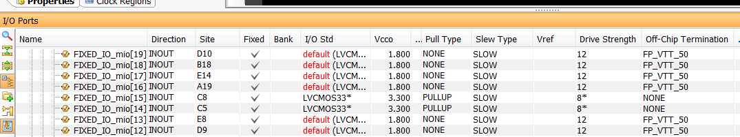
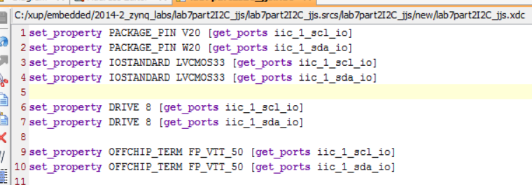
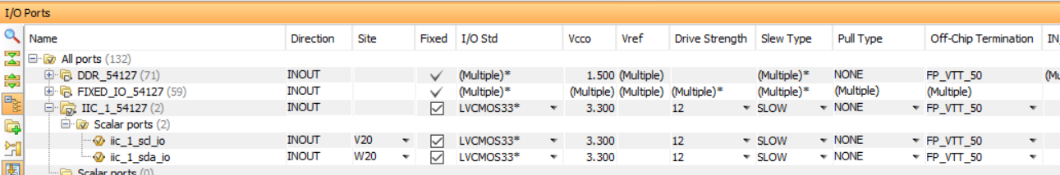
Lab #9 Part 1: Choose SelectIO pins for I2C 1
After Synthesis is done, open Synthesized Design and choose Layout->I/O Planning to see I/O Ports and pin assignments
Notice I2C 0 pins are assigned to Fixed-IO pins
Assign Pin V20 to I2C 1 clock pin and Pin W20 to I2C 1 data pin.
Save Design Constraint file (.xdc) generated for pins V20 and W20
Zynq-7000 All Programmable SoC, Technical Reference Manual, UG585

Slide 22
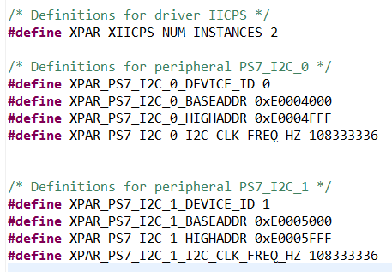
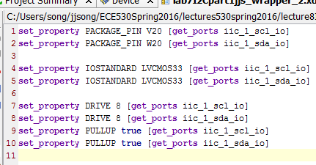
Lab #9 Part 1: XDC File and xparameters.h
Save Xilinx Design Constraint (XDC) file for pins V20 and W20
Generate the bit stream file
Export hardware with the bit steam file
Launch SDK to see two I2C devices defined in xparameters.h
Program FPGA and Run Launch on hardware (GDB) to read temperatures
Zynq-7000 All Programmable SoC, Technical Reference Manual, UG585

Slide 23
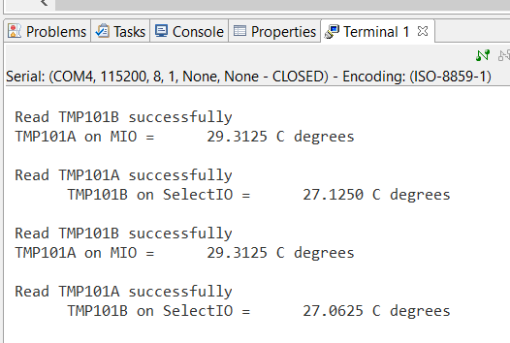
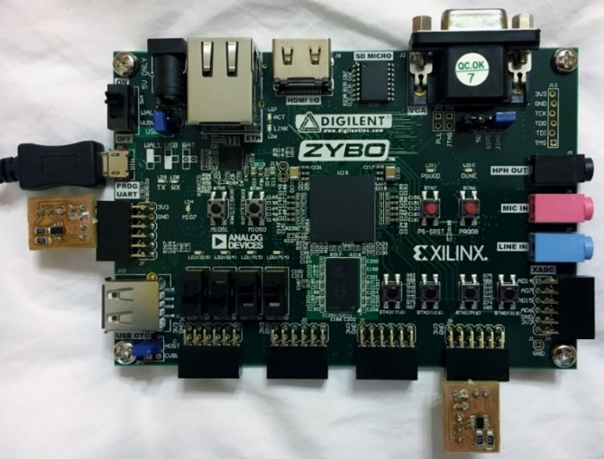

Lab #9 Part 1: Two TMP101 Breakout Boards on Zybo Board
12 bit resolution
Minimum temperature is $0.0625℃$

Slide 24
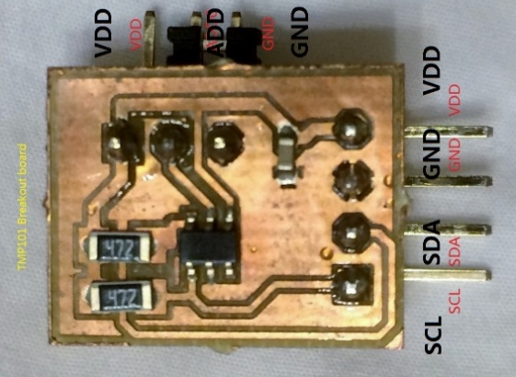
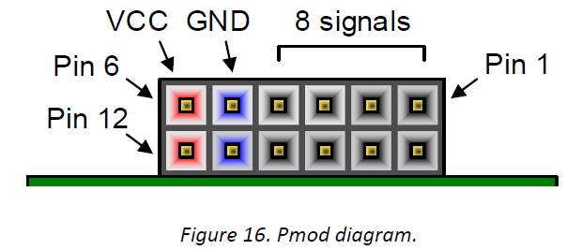
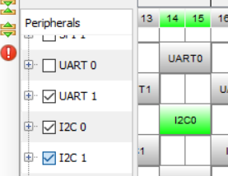
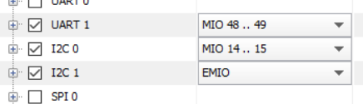
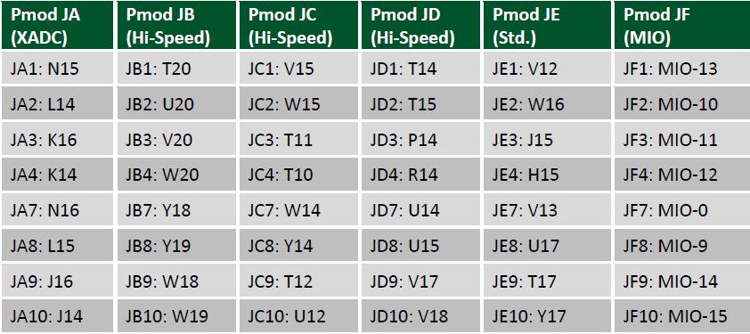

Slide 25
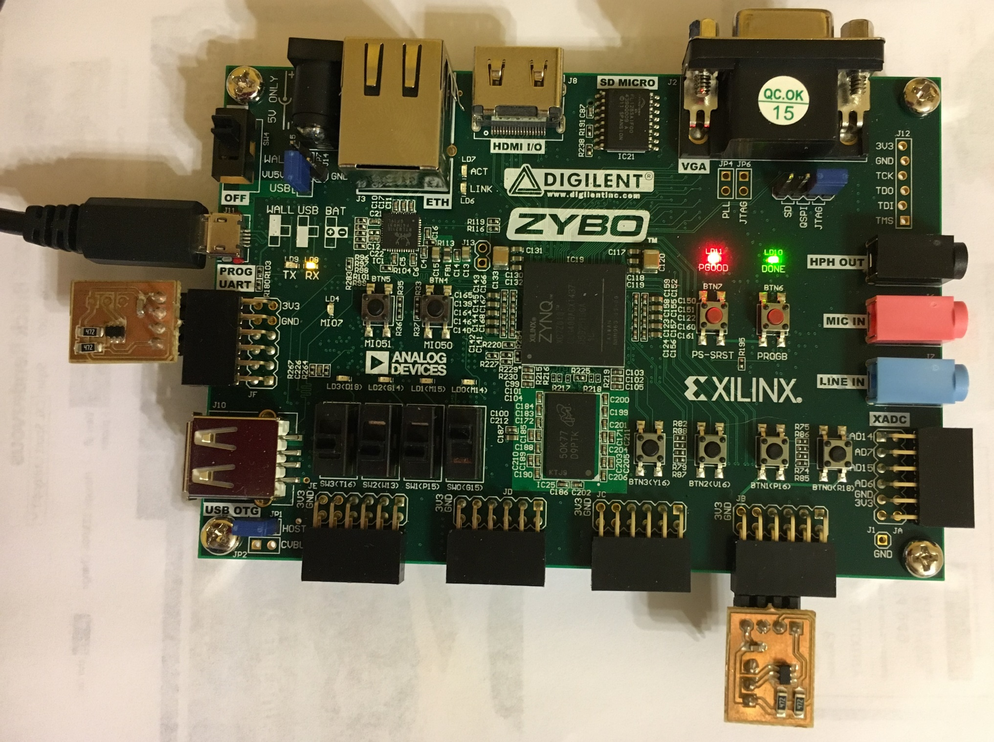

Slide 26
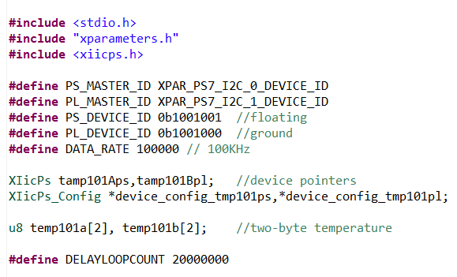

My I2C Program Variable Definitions
Constants and Variables
Read Temperature and print the first byte only in Celsius

Slide 27
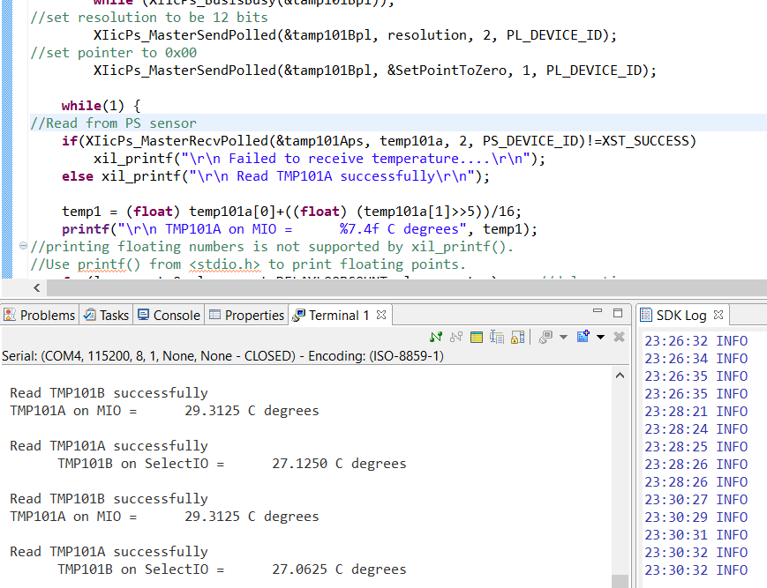

Slide 28
I2C Controller of Zynq 7000
Chapter 20 I2C Controller, Zynq-7000 All Programmable SoC, Technical Reference Manual, UG585 (v1.10) February 23, 2015
I2C bus specification version 2
Supports 16-byte FIFO
Programmable normal and fast bus data rates
Master Mode
Write transfer
Read transfer
Extended address support
Support HOLD for slow processor service
Supports TO interrupt flag to avoid stall condition
Slave Monitor Mode
Chapter 20, Zynq-7000 All Programmable SoC, Technical Reference Manual, UG585

Slide 29
I2C Controller of Zynq 7000
Slave Mode
Slave transmitter
Slave receiver
Fully programmable slave response address
Supports HOLD to prevent overflow condition
Supports TO interrupt flag to avoid stall condition
Software can poll for status or function as interrupt-driven device
Programmable interrupt generation
Chapter 20, Zynq-7000 All Programmable SoC, Technical Reference Manual, UG585

Slide 30
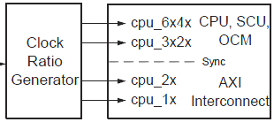
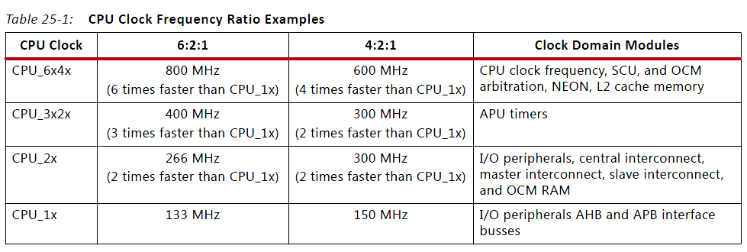
The PS Clock Subsystem of Cortex A9
cpu_6x4x clock is used by CPU and SCU
CPU – Central Processing Unit
SCU – Snoop Control Unit
cpu_3x2x clock are used by OCM
OCM – One Chip Memory unit
cpu_2x clock are used by AXI
cpu_1x clock are used by slower buses such as the Advanced Peripheral Bus
Chapter 25 Clock, Zynq-7000 All Programmable SoC, Technical Reference Manual, UG585

Slide 31
Advanced Peripheral Bus (APB) of Zynq 7000
APB (Advanced Peripheral Bus) low bandwidth control accesses, for example register interfaces on system peripherals. Similar to AHB, but a much reduced, low complexity signal list.
Each Cortex-A9 processor has a standard 32-bit APB slave port that operates at the CPU_1x clock Frequency
CPU_1X clock is 4 times slower than CPU core clock
If CPU core clock is 600MHz, CPU_1x clock is 150MHz
Chapter 25 Clock, Zynq-7000 All Programmable SoC, Technical Reference Manual, UG585

Slide 32
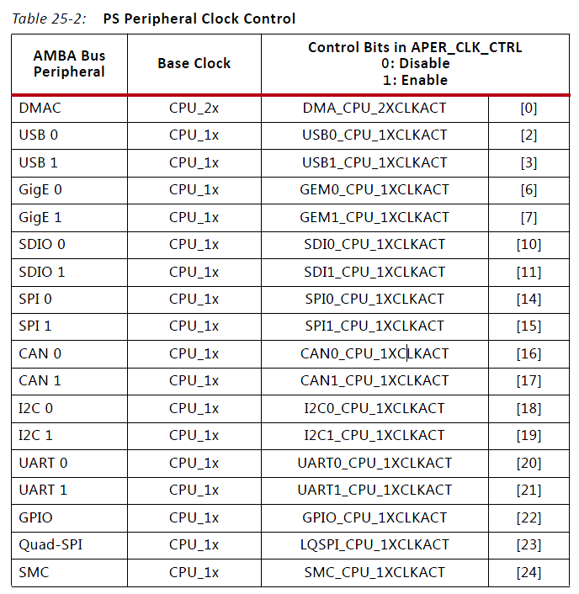
Base Clock and PS Peripheral Clock Control of Zynq 7000
Most peripheral controllers use cpu-1x clock
Except for DMAC
Chapter 25 Clock, Zynq-7000 All Programmable SoC, Technical Reference Manual, UG585

Slide 33
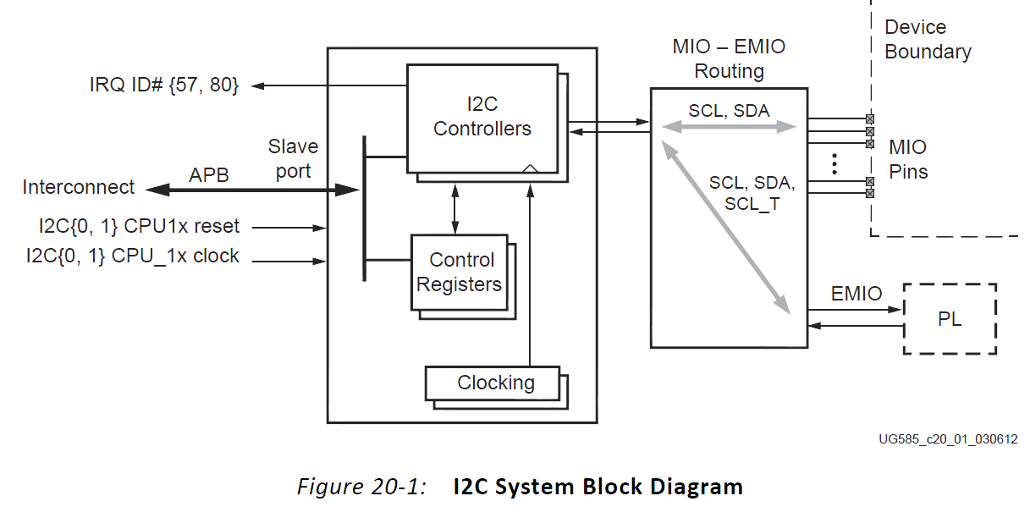
I2C Controller System Block Diagram of Zynq 7000
Each Cortex-A9 processor has a standard 32-bit APB slave port that operates at the CPU_1x clock Frequency
APB (Advanced Peripheral Bus) low bandwidth control accesses, for example register interfaces on system peripherals. Similar to AHB, but a much reduced, low complexity signal list.
Two I2C Controllers: I2C 0 and I2C 1
SCL and SDA can be connected from MIO or EMIO
SCL_T
Chapter 20 I2C Controller, Zynq-7000 All Programmable SoC, Technical Reference Manual, UG585

Slide 34
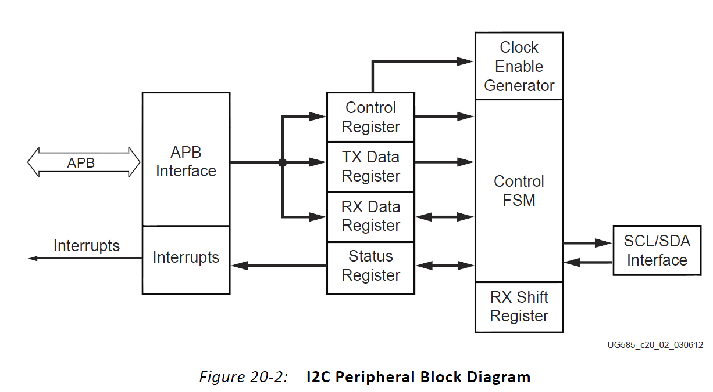
Master Mode of I2C Controller of Zynq 7000
An I2C transfer can only be initiated by the APB host and two types of transfers can be performed.
Write transfer, where the I2C becomes master transmitter
Read transfer, where the I2C becomes master receiver
Control Register
TX Data Register
RX Data Register
Slave Address Register
Status Register
Chapter 20 I2C Controller, Zynq-7000 All Programmable SoC, Technical Reference Manual, UG585

Slide 35
Write Transfer of Master Mode of I2C Controller of Zynq 7000
Write to the control register to set up SCL speed and addressing mode.
Set the MS, ACKEN, and CLR_FIFO bits and clear the RW bit in the Control register.
If required, set the HOLD bit. Otherwise write the first byte of data to the I2C Data register.
Write the slave address into the I2C address register. This initiates the I2C transfer.
Continue to load the remaining data to be sent to the slave by writing to the I2C Data register.
The data is pushed in the FIFO each time the host writes to the I2C Data register.
The COMP bit is set in the interrupt status register, When all data is transferred successfully.
If the HOLD bit is set, the I2C interface holds the SCL line Low. Otherwise, the I2C interface generates a STOP condition.

Slide 36
Read Transfer of Master Mode of I2C Controller of Zynq 7000
Write to the Control register to set up the SCL speed and addressing mode.
Set the MS, ACKEN, CLR_FIFO bits, and the RW bit in the Control register.
If the host wants to hold the bus after the data is received, it must also set the HOLD bit.
Write the number of requested bytes in the Transfer Size register.
Write the slave address in the I2C Address register. This initiates the I2C transfer.
A NACK is automatically sent after receiving the last expected byte and terminates
the transfer by generating a STOP condition.
If the HOLD bit is set during a master read transfer, the I2C interface drives the SCL line Low.
Chapter 20 I2C Controller, Zynq-7000 All Programmable SoC, Technical Reference Manual, UG585

Slide 37

Clock Generator of I2C Controller of Zynq 7000
In slave mode, the clock enable is used to extract synchronization information for correct sampling of the SDA line.
In master mode, the clock enable is used to establish a time base for generating the desired SCL frequency.
Zybo CPU clock is 640MHz, therefore cpu_1x clock is 160MHz
Chapter 20 I2C Controller, Zynq-7000 All Programmable SoC, Technical Reference Manual, UG585

Slide 38
Start-up Sequence of I2C Controller of Zynq 7000
Reset controller
Configure I/O signal routing: I2C signals SCL and SDA can be routed to either MIO or EMIO.
Configure I2C Clock
Controller Configuration: Program I2C transfer parameters using i2c.Control_reg0 etc.
Configure Interrupts
Data Transfers: Transfers in master mode and slave monitor mode
Chapter 20 I2C Controller, Zynq-7000 All Programmable SoC, Technical Reference Manual, UG585

Slide 39
Example: Master Write Transfer of I2C Controller of Zynq 7000
Configure the Control parameters. Write 0x0000_324E to i2c.Control_reg0 register:
Select Master mode: Set i2c.Control_reg0[MS] = 1.
Set Direction of transfer as Master Transmitter: Set i2c.Control_reg0[RW] = 0.
Select Normal Addressing [7-bit] mode: Set i2c.Control_reg0[NEA] = 1.
Enable the transmission of ACK: Set i2c.Control_reg0[ACKEN] = 1.
Clear the FIFOs: Set i2c.Control_reg0[CLR_FIFO] = 1.
Program the clock divisors:
Set i2c.Control_reg0[divisor_a] = 0.
Set i2c.Control_reg0[divisor_b] = 50.
These divisors generate an I2C SCL of 99 KHz using the CPU_1X clock of 111 MHz.
Chapter 20 I2C Controller, Zynq-7000 All Programmable SoC, Technical Reference Manual, UG585

Slide 40
Example: Master Read Using Polled Method of I2C Controller of Zynq 7000
Set direction of transfer as read and clear the FIFOs. Write 0x41 to i2c.Control_reg0.
Clear interrupts. Read and write back the read value to i2c.Interrupt_status_reg0.
Write read data count to transfer size register and hold bus if required. Write read data count value to i2c.Transfer_size_reg0. If read data count greater than FIFO depth, set i2c.Control_reg0 [HOLD] = 1.
Write the slave address. Write the address to the i2c.I2C_address_reg0 register.
Chapter 20 I2C Controller, Zynq-7000 All Programmable SoC, Technical Reference Manual, UG585

Slide 41
Example: Master Read Using Polled Method of I2C Controller of Zynq 7000
Wait for data to be received into the FIFO. Poll on i2c.Status_reg0 [RXDV] = 1.
If i2c.Status_reg0 [RXDV] = 0, and any of i2c.Interrupt_status_register [NACK], i2c.Interrupt_status_register [ARB_LOST], i2c.Interrupt_status_register [RX_OVF], i2c.Interrupt_status_register [RX_UNF] interrupts are set, then stop the transfer and report the error, otherwise continue to poll on i2c.Status_reg0 [RXDV].
If i2c.Status_reg0 [RXDV] = 1, and if any of i2c.Interrupt_status_register [NACK], i2c.Interrupt_status_register [ARB_LOST], i2c.Interrupt_status_register [RX_OVF], i2c.Interrupt_status_register [RX_UNF] interrupts are set, then stop the transfer and report the error. Otherwise, go to next step.
Read data and update count.
Read data from FIFO until i2c.Status_reg0[RXDV] = 1. Decrement the read data count and if it is less than or equal to the FIFO depth, clear i2c.Control_reg0[HOLD].
Check for Completion of transfer.
If total read count reaches zero, poll on i2c.Interrupt_status_reg0 [COMP] = 1. Otherwise go to Wait for data to be received into the FIFO.

Slide 42

I2C Level 1 Software Driver in the PS Block: iicps v2_3
file:///C:/Xilinx/SDK/2014.4/data/embeddedsw/XilinxProcessorIPLib/drivers/iicps_v2_3
Support I2C hardware controller in the PS block
Base Addresses of I2C 0 and I2C 1 are fixed at (UG585)
0xE0004000
0xE0005000
I2C software driver in the PS block
either a master or a slave on the IIC bus.
supports both interrupt mode transfer and polled mode transfer
Only 7-bit address is used in the driver, although the hardware also supports 10-bit address.

Slide 43
xiicps_hw.h – Hardware Definition File
Addresses of all I2C module registers are defined
#define XIICPS_CR_OFFSET0x00 /**< 32-bit Control */
#define XIICPS_SR_OFFSET0x04 /**< Status */
#define XIICPS_ADDR_OFFSET0x08 /**< IIC Address */
#define XIICPS_DATA_OFFSET0x0C /**< IIC FIFO Data */
#define XIICPS_ISR_OFFSET0x10 /**< Interrupt Status */
#define XIICPS_TRANS_SIZE_OFFSET0x14 /**< Transfer Size */
#define XIICPS_SLV_PAUSE_OFFSET0x18 /**< Slave monitor pause */
#define XIICPS_TIME_OUT_OFFSET0x1C /**< Time Out */
#define XIICPS_IMR_OFFSET0x20 /**< Interrupt Enabled Mask */
#define XIICPS_IER_OFFSET0x24 /**< Interrupt Enable */
#define XIICPS_IDR_OFFSET0x28 /**< Interrupt Disable */

Slide 44
xiicps.h – I2C Driver Header File
#define XIICPS_CR_OFFSET0x00 /**< 32-bit Control */
#define XIICPS_SR_OFFSET0x04 /**< Status */
#define XIICPS_ADDR_OFFSET0x08 /**< IIC Address */
#define XIICPS_DATA_OFFSET0x0C /**< IIC FIFO Data */
#define XIICPS_ISR_OFFSET0x10 /**< Interrupt Status */
#define XIICPS_TRANS_SIZE_OFFSET0x14 /**< Transfer Size */
#define XIICPS_SLV_PAUSE_OFFSET0x18 /**< Slave monitor pause */
#define XIICPS_TIME_OUT_OFFSET0x1C /**< Time Out */
#define XIICPS_IMR_OFFSET0x20 /**< Interrupt Enabled Mask */
#define XIICPS_IER_OFFSET0x24 /**< Interrupt Enable */
#define XIICPS_IDR_OFFSET0x28 /**< Interrupt Disable */

Slide 45
typedef struct {
u16 DeviceId; /**< Unique ID of device */
u32 BaseAddress; /**< Base address of the device */
u32 InputClockHz; /**< Input clock frequency */
} XIicPs_Config;
XIicPs tmp101a;
XIicPs_Config *tmp101a_config;
typedef struct {
XIicPs_Config Config;/* Configuration structure */
u32 IsReady;/* Device is initialized and ready */
u32 Options;/* Options set in the device */
u8 *SendBufferPtr;/* Pointer to send buffer */
u8 *RecvBufferPtr;/* Pointer to recv buffer */
int SendByteCount;/* Number of bytes still expected to send */
int RecvByteCount;/* Number of bytes still expected to receive */
int CurrByteCount;/* No. of bytes expected in current transfer */
int UpdateTxSize;/* If tx size register has to be updated */
int IsSend;/* Whether master is sending or receiving */
XIicPs_IntrHandler StatusHandler; /* Event handler function */
void *CallBackRef;/* Callback reference for event handler */
} XIicPs;

Slide 46
XIicPS_Lookupconfig() and XIicPs_CfgInitialize()
XIicPs_LookupConfig(DeviceId) - Use the device identifier to find the static configuration structure defined in xiicps_g.c. This is setup by the tools. For some operating systems the config structure will be initialized by the software and this call is not needed.
XIicPs_CfgInitialize(InstancePtr, CfgPtr, EffectiveAddr) - Uses a configuration structure provided by the caller. If running in a system with address translation, the provided virtual memory base address replaces the physical address in the configuration structure.

Slide 47
XIicPs_MasterRecvPolled() – to read from an I2C device
int XIicPs_MasterRecvPolled(XIicPs *InstancePtr, u8 *MsgPtr,
int ByteCount, u16 SlaveAddr);
InstancePtr is a pointer to the XIicPs instance.
MsgPtr is the pointer to the receive buffer.
ByteCount is the number of bytes to be received.
SlaveAddr is the address of the slave we are receiving from.
Return
- XST_SUCCESS if everything went well.
- XST_FAILURE if timed out.
MsgPtr[0] receives the 1st byte, MsgPtr[1] receives the 2nd byte, etc.

Slide 48
XIicPs_MasterSendPolled() – to write to an I2C device
int XIicPs_MasterSendPolled(XIicPs *InstancePtr, u8 *MsgPtr, int ByteCount, u16 SlaveAddr)
InstancePtr is a pointer to the XIicPs instance.
MsgPtr is the pointer to the send buffer.
ByteCount is the number of bytes to be sent.
SlaveAddr is the address of the slave we are sending to.
return
- XST_SUCCESS if everything went well.
- XST_FAILURE if timed out.

Slide 49
XIicPs_SetSClk()
int XIicPs_SetSClk(XIicPs *InstancePtr, u32 FsclHz)
InstancePtr is a pointer to the XIicPs instance.
FsclHz is the clock frequency in Hz. The two most common clock rates are 100KHz and 400KHz.
return
- XST_SUCCESS if options are successfully set.
- XST_DEVICE_IS_STARTED if the device is currently transferring data. The transfer must complete or be aborted before setting options.
- XST_FAILURE if the Fscl frequency can not be set.
The clock can not be faster than the input clock divide by 22.

Slide 50
XIicPs_Config *XIicPs_LookupConfig(u16 DeviceId)
Looks up the device configuration based on the unique device ID. A table contains the configuration info for each device in the system.
DeviceId contains the ID of the device to look up the configuration for.
Return
A pointer to the configuration found or
NULL if the specified device ID was not found.

